Slide 1
Microprocessor Systems and Interfacing CPE 342
Lecture 1- Week 5

Slide 2
PPI Applications
Outline
Mode 0 Operation :Keyboard Interfacing with PPI

Slide 3
Key Matrix Interface
A small key matrix that contains sixteen switches interfaced to port A and port B.
Switches are formed in 4 x 4 matrix
Keys are organized as four rows (ROW₀-ROW₃) and four columns (COL₀-COL₃)
Each row is connected to 5v through a 10 Kohms resistor
82C55 is decoded at 50H-53H
PortA is programmed as Input Port
PortB is programmed as Output Port

Slide 4
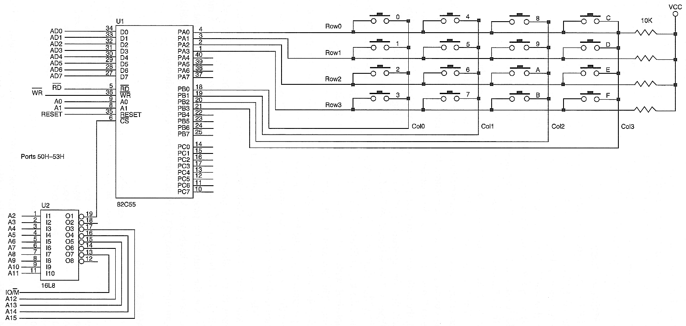
Keyboard Interface Example

Slide 5
Flow Chart

Slide 6
Assembly Code
;assembly language version;
;KEY scans the keyboard and returns the key code in AL.
COLS EQU 4
ROWS EQU 4
PORTA EQU 50H
PORTB EQU 51H
KEY PROC NEAR USES CX BX
MOV BL,FFH ;compute row mask
SHL BL,ROWS
MOV AL,0
OUT PORTB,AL ;place zeros on Port B
.REPEAT ;wait for release
.REPEAT
CALL SCAN
.UNTIL ZERO?
CALL DELAY10
CALL SCAN
.UNTIL ZERO?

Slide 7
.REPEAT ;wait for key
.REPEAT
CALL SCAN
.UNTIL !ZERO?
CALL DELAY10
CALL SCAN
.UNTIL !ZERO?
MOV CX,00FEH
.WHILE 1 ;find column
MOV AL,CL
OUT PORTB,AL
CALL SHORTDELAY ;see text
CALL SCAN
.BREAK !ZERO?
ADD CH,COLS
ROL CL,1
.ENDW
.WHILE 1 ;find row
SHR AL,1
.BREAK .IF !CARRY?
INC CH
.ENDW

Slide 8
MOV AL,CH ;get key code
RET
KEY ENDP
SCAN PROC NEAR
IN AL,PORTA ;read rows
OR AL,BL
CMP AL,0FFH ;test for no keys
RET
SCAN ENDP

Slide 9
Task
Verify the working of the code by assuming Key 6 is pressed.

